Slide 1


Blu LeBlanc
11/26/25

Slide 2
Outline
Executive Summary
Introduction
Methodology
Results
Conclusion
Appendix

Slide 3
Executive Summary
Methodologies:
Data Collection -> web scraping SpaceX API
Exploratory Data Analysis -> data wrangling, data manipulation, data visualization
Machine Learning Classification Prediction Models
Summary of all results:
Collected data on SpaceX rocket launches
EDA utilized to identify valuable features to predict outcome of launch
ML models yielded best model to predict success or failure of SpaceX launch, given features of the launch

Slide 4
Introduction
SpaceX claims much lower cost (62 million) for Falcon 9 launches because they can reuse the first stage. By determining if a first stage will land successfully, we can predict the cost of a SpaceX launch
Project Goal: Predict if Falcon 9 first stage will land successfully using features from SpaceX launch data

Slide 5

Section 1

Slide 6
Methodology
Executive Summary
Data collection methodology:
Scraped SpaceX API for launch data
Perform data wrangling
Utilized Pandas to track landing outcomes and perform mean imputation
Perform exploratory data analysis (EDA) using visualization and SQL
Perform interactive visual analytics using Folium and Plotly Dash
Perform predictive analysis using classification models
Compared various classification models from sci-kit learn with GridSearchCV optimization

Slide 7

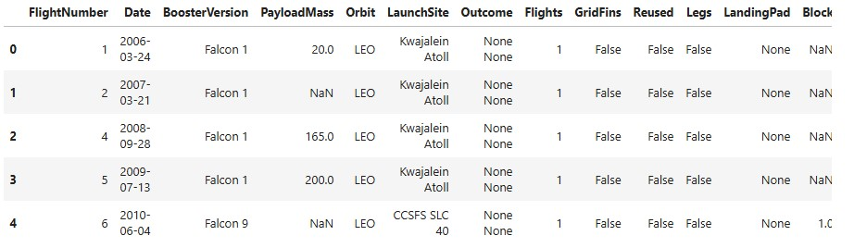
Libraries: requests, pandas
Helper functions to extract information using identification numbers in launch data
Pulled data from SpaceX API
Converted json result into pandas dataframe
Called helper functions to replace IDs with launch information
Constructed final dataframe
Data Collection

Slide 8
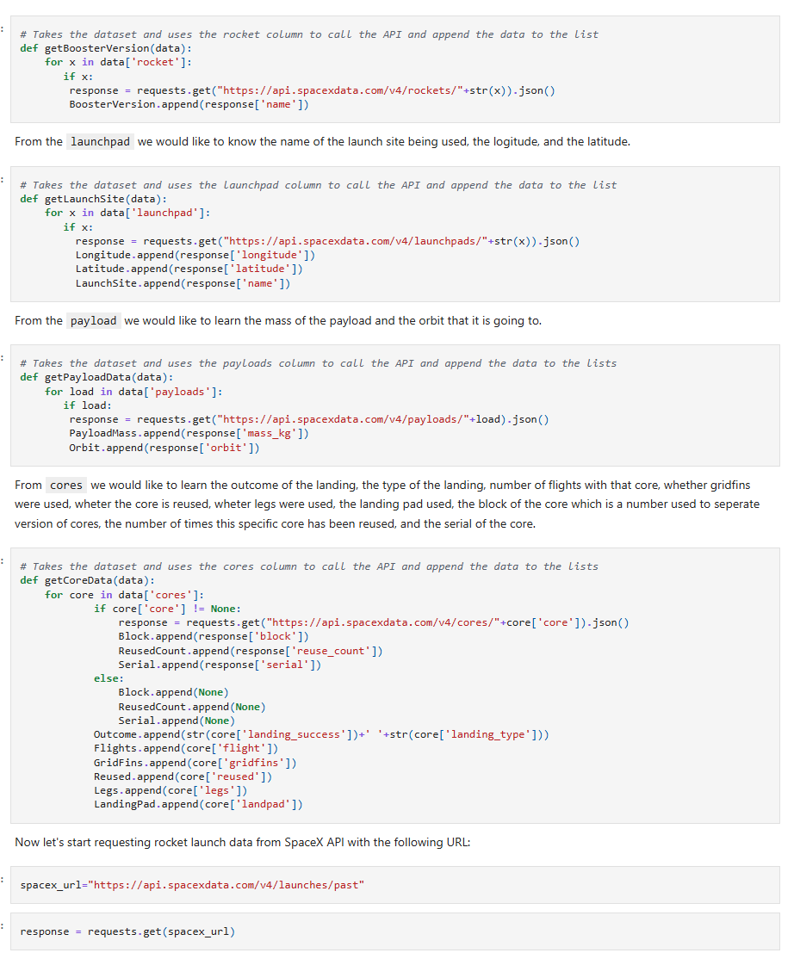
Data Collection – SpaceX API
Data Collection helper functions
Notebook: https://github.com/Blu-LeBlanc/IBM-Data-Science-Labs/blob/main/SpaceX_Data%20Collection%20API.ipynb

Slide 9
Data Wrangling
Libraries: Pandas, Numpy
Mean imputation on PayloadMass column
Filtered for Falcon 9
Created count of landing outcomes
Created Landing Class label column

Slide 10
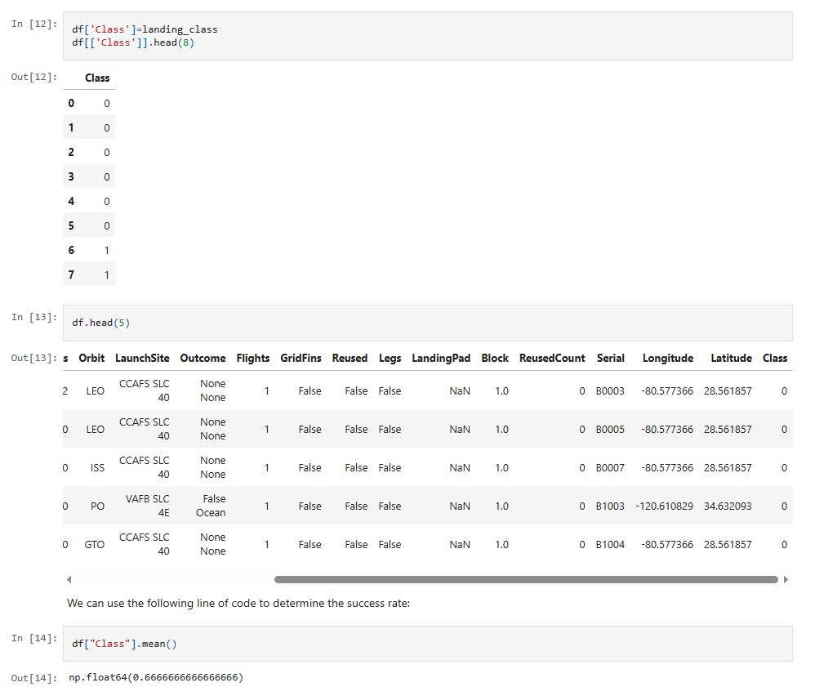
Data Wrangling – Landing Outcomes
Data Wrangling samples
Notebook: https://github.com/Blu-LeBlanc/IBM-Data-Science-Labs/blob/main/SpaceX_Data%20Wrangling.ipynb

Slide 11
EDA with Data Visualization
Libraries: pyplot, seaborn, pandas
Charts:
Scatter: FlightNumber vs PayloadMass, FlightNumber vs LaunchSite, PayloadMass vs LaunchSite, FlightNumber vs Orbit, PayloadMass vs Orbit
Bar: Success Rate of Orbit Type
Line: Launch Success Yearly Trend
Data visualizations used to determine which variables affect success rate. Performed feature selection and encoding
Notebook: https://github.com/Blu-LeBlanc/IBM-Data-Science-Labs/blob/main/SpaceX_EDA%20Data%20Viz.ipynb

Slide 12
EDA with SQL
Libraries: sqlite3
EDA Queries:
Display the name of the unique launch sites in the space mission
Display 5 records where launch sites begin with the string ‘CCA’
Display the total payload mass carried by boosters launched by NASA (CRS)
Display average payload mass carried by booster version F9 v1.1
List the date when the first succesful landing outcome in ground pad was acheived.
List the names of the boosters which have success in drone ship and have payload mass greater than 4000 but less than 6000
List the total number of successful and failure mission outcomes
List all the booster_versions that have carried the maximum payload mass, using a subquery with a suitable aggregate function.
List the records which will display the month names, failure landing_outcomes in drone ship ,booster versions, launch_site for the months in year 2015.
Rank the count of landing outcomes (such as Failure (drone ship) or Success (ground pad)) between the date 2010-06-04 and 2017-03-20, in descending order.
Notebook: https://github.com/Blu-LeBlanc/IBM-Data-Science-Labs/blob/main/SpaceX_EDA%20SQL.ipynb

Slide 13
Build an Interactive Map with Folium
Interactive Map tasks:
Marked all launch sites on map using circles and coordinates
Created green and red markers to denote success/failed launches for each site on the map
Created distance markers to calculate the distance between launch sites and objects
Summarize what map objects such as markers, circles, lines, etc. you created and added to a folium map
Interactive map can be used to view launch site locations, launch sites with highest success rates, distance between proximities and launch sites
Notebook: https://github.com/Blu-LeBlanc/IBM-Data-Science-Labs/blob/main/SpaceX_Interactive_Visual_Analytics_with_Folium_lab.ipynb

Slide 14
Build a Dashboard with Plotly Dash
Dashboard tasks:
Add Launch Site drop-down selector
Add callback function to render success pie chart for launch site
Add range slider for choosing Payload
Add callback function to render success scatter plot for payload
Dashboard can answer questions about comparing success rate of launch sites, comparing success rates of payload ranges, comparing success rate of F9 Booster versions
Notebook: https://github.com/Blu-LeBlanc/IBM-Data-Science-Labs/blob/main/spacex_dash_app.py

Slide 15
Predictive Analysis (Classification)
Libraries: sklearn, train_test_split, GridSearchCV, LogisticRegression, SVC, DecisionTreeClassifier, KNeighborsClassifier
Converted Class to array format
Standardized and split data into train test split
Created different classification models. Models: LR, SVM, Tree, KNN
Evaluated each classification model with accuracy and confusion matrix
Found best hyperparameters for SVM, Classification Trees, and Logistic Regression using GridSearchCV and Sci-kit Learn functions
Notebook: https://github.com/Blu-LeBlanc/IBM-Data-Science-Labs/blob/main/SpaceX_Machine%20Learning%20Prediction.ipynb

Slide 16

Results
Exploratory Data Analysis ->
Created SpaceX launch dataframe to predict outcome of rocket launch
Determined best features for analysis
Interactive analytics demo in screenshots ->
Created interactive Folium maps to view rocket launch sites and successes
Created Dashboard to view statistics on launch sites
Predictive analysis results ->
Compared multiple binary classification models
Optimized models with GridSearchCV
Found best model: Decision Tree Classifier

Slide 17

Section 2

Slide 18
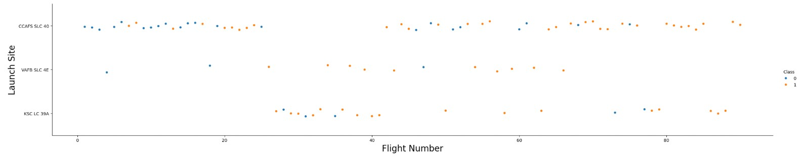
Flight Number vs. Launch Site
Certain launch sites were out-of-use/not used for flights. ;
CCAFS SLC 40 has the highest usage and more successful flights more recently
General success rate improved over flight numbers

Slide 19
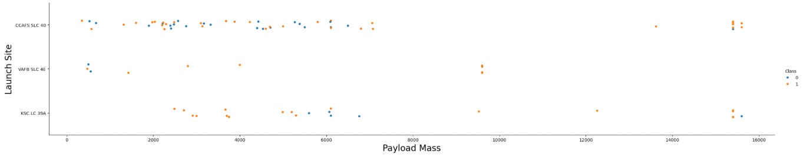
Payload vs. Launch Site
For VAFB-SLC launchsite, there are no rockets launched for heavypayload mass (greater than 10000)
Overall, very few rockets launched with heavypayload mass

Slide 20
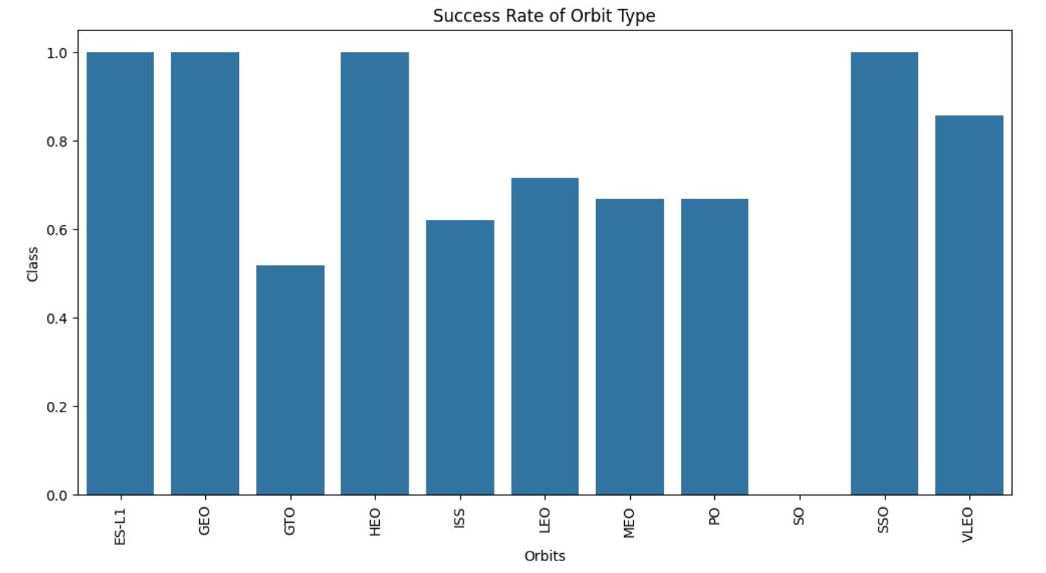
Success Rate vs. Orbit Type
Orbits with highest success rate: ES-L1, GEO, HEO, SSO

Slide 21
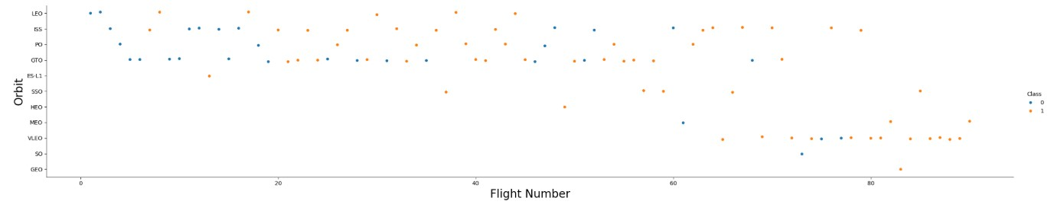
Flight Number vs. Orbit Type
LEO orbit has a positive relation between success and number of flights
GTO orbit has no relation between flight number and success
Certain orbits, like GEO, were not used until recently

Slide 22
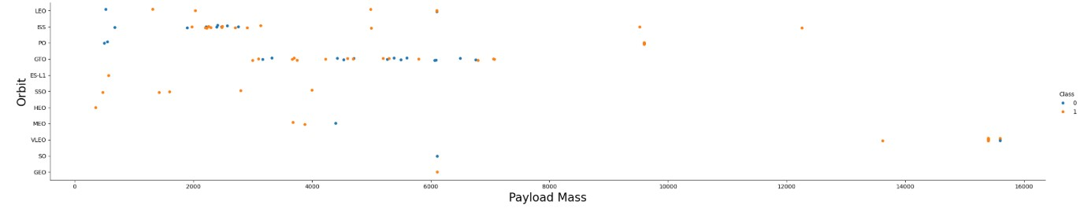
Payload vs. Orbit Type
With heavy payloads, the successful landing or positive landing rate are more for Polar, LEO, ISS
For GTO, it is difficult to distinguish between successful and unsuccessful landings as both outcomes are present

Slide 23
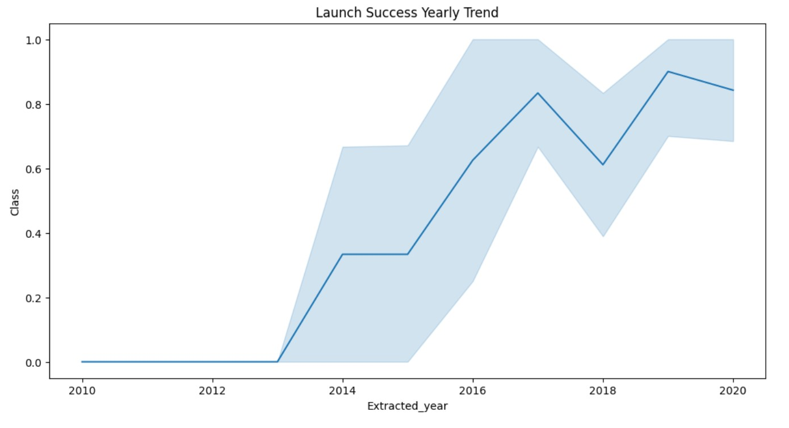
Launch Success Yearly Trend
Success rate kept increasing until a slight dip from 2017 to 2018
Success rate dropped again from 2019 to 2020, less steep decline this time

Slide 24
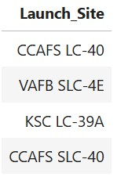
All Launch Site Names

Slide 25
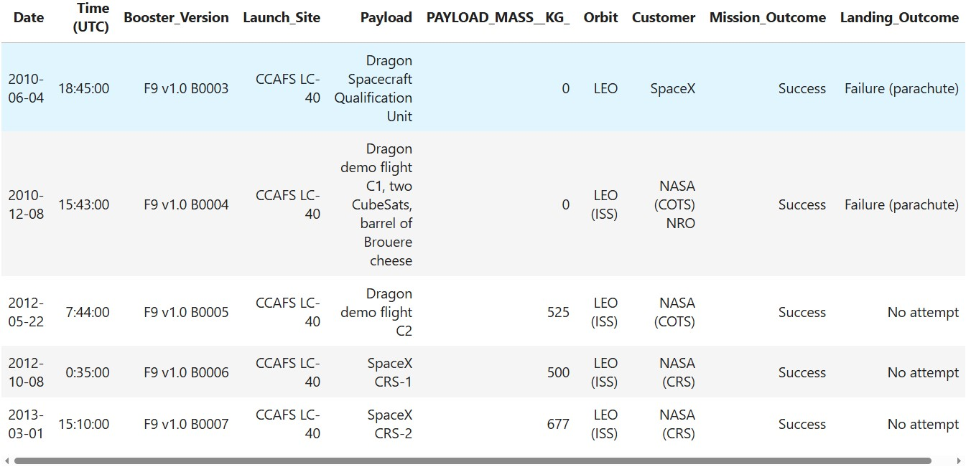
Launch Site Names Begin with 'CCA'

Slide 26
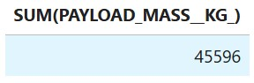
Total Payload Mass

Slide 27
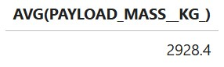
Average Payload Mass by F9 v1.1

Slide 28
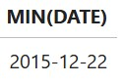
First Successful Ground Landing Date

Slide 29
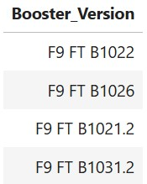
Successful Drone Ship Landing with Payload between 4000 and 6000

Slide 30
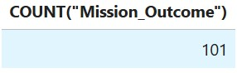
Total Number of Successful and Failure Mission Outcomes

Slide 31
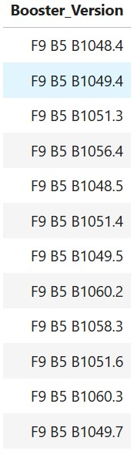
Boosters Carried Maximum Payload

Slide 32
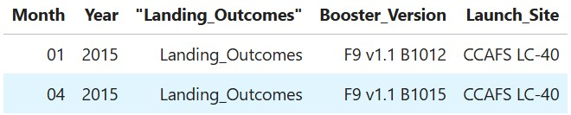
2015 Launch Records

Slide 33
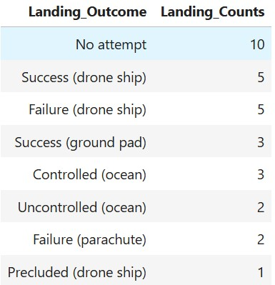
Rank Landing Outcomes Between 2010-06-04 and 2017-03-20

Slide 34

Section 3

Slide 35
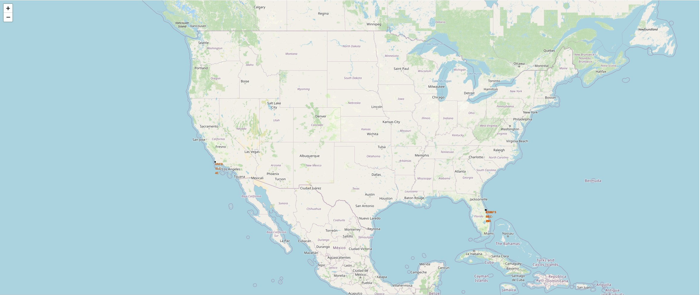
Folium Launch Site Locations
Launch Sites located on West Coast (California) and East Coast (Florida)

Slide 36
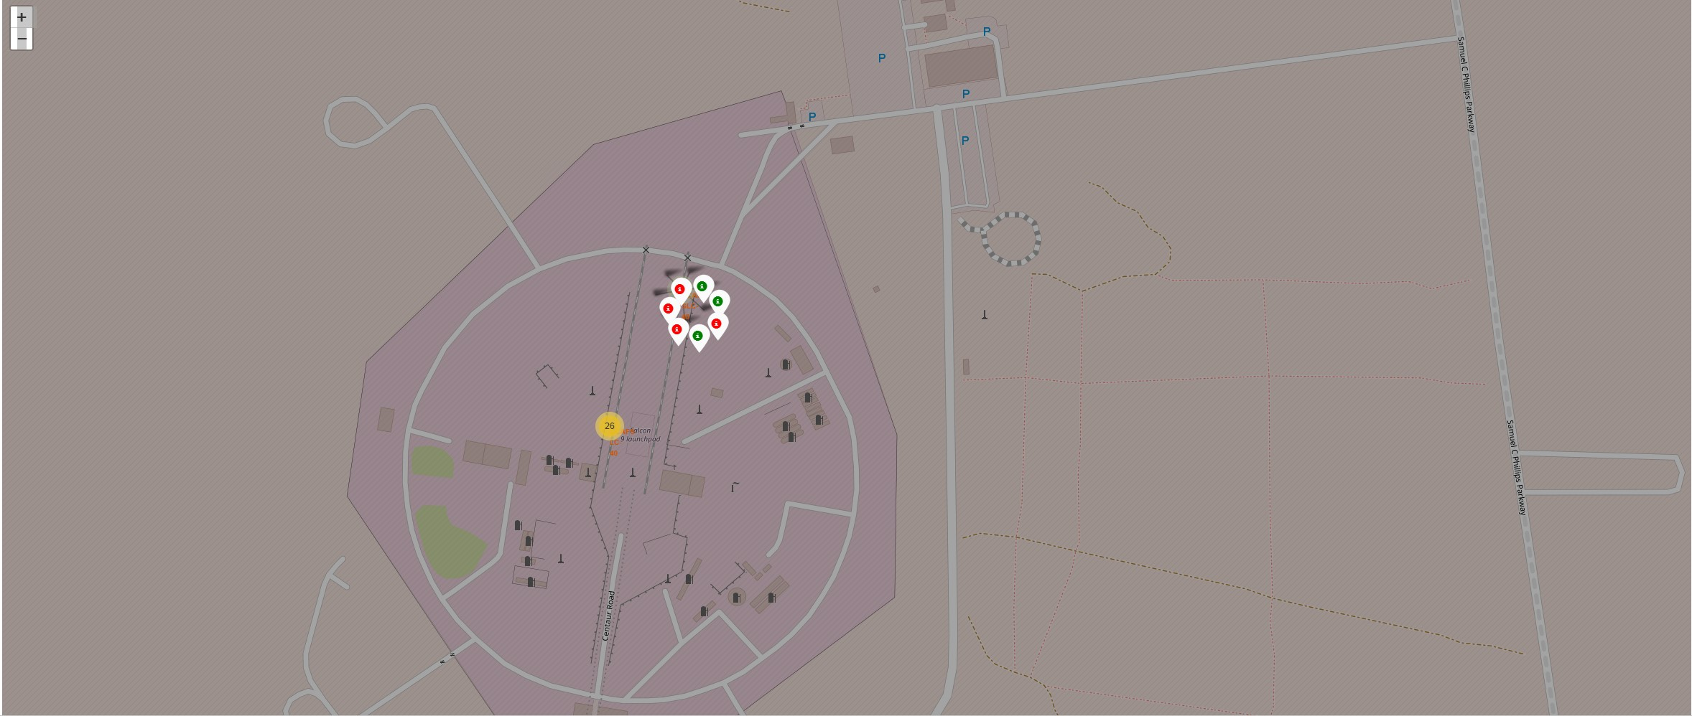
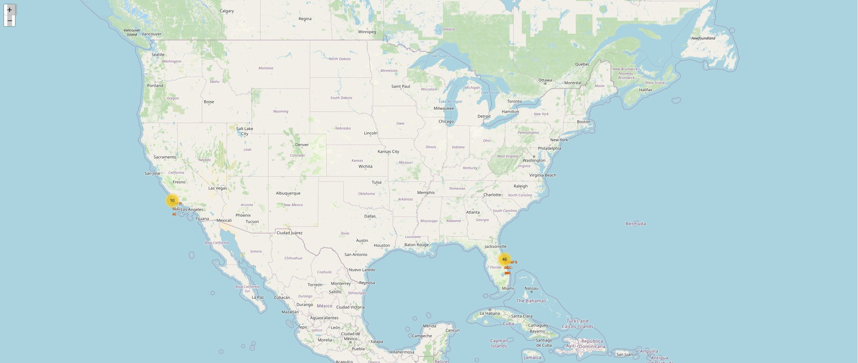
Folium Launch Outcomes
Showcases successful launches (green) and failed launches (red) for each launch site location

Slide 37
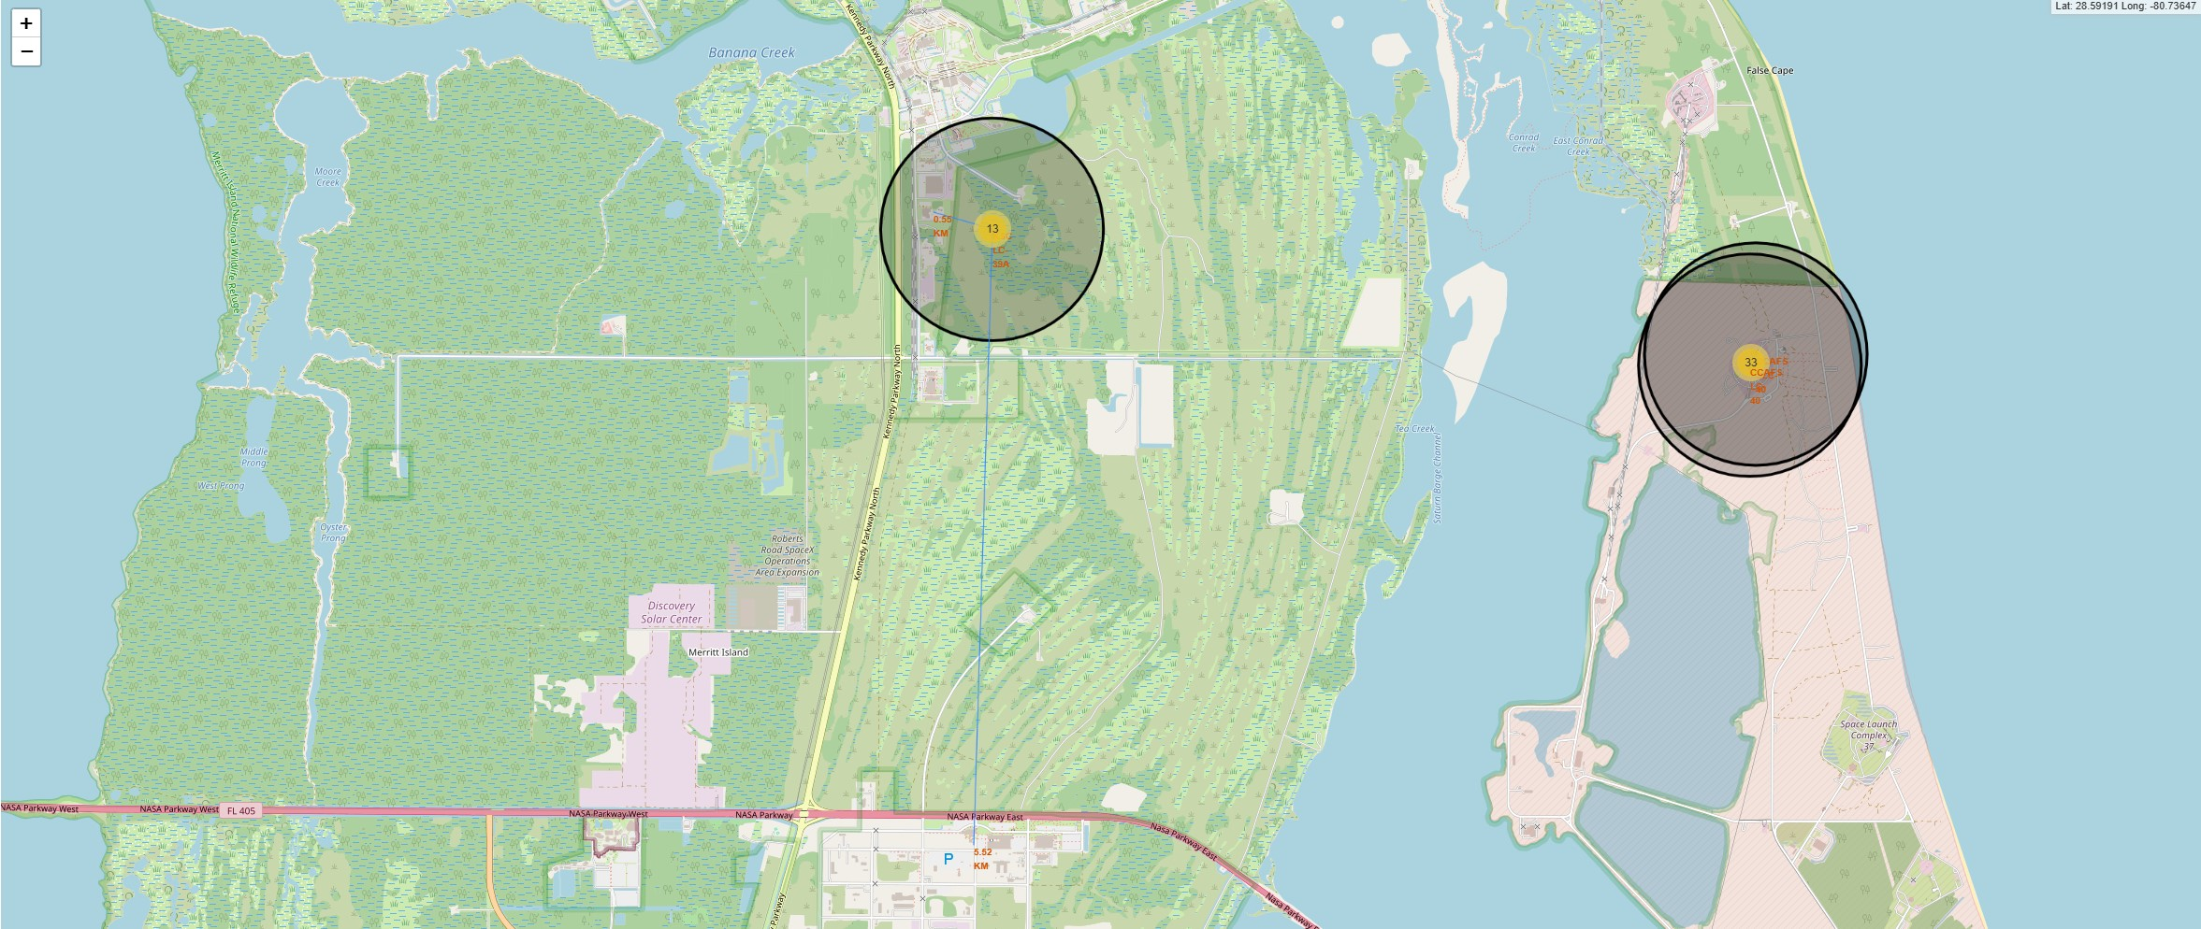
Folium Proximity Map
Utilized Distance calculations on interactive map for the user to determine the distance between a launch site and various proximities
Proximities include body of water, major road, building, etc…

Slide 38

Section 4

Slide 39
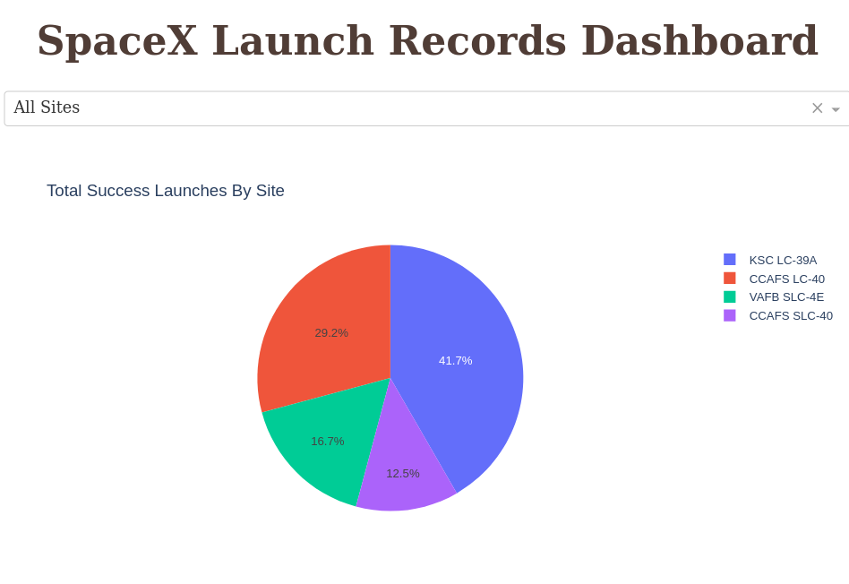
Total Success Launches by Site
Visualizes the success likelihood of launch sites to determine the “best” launch site

Slide 40
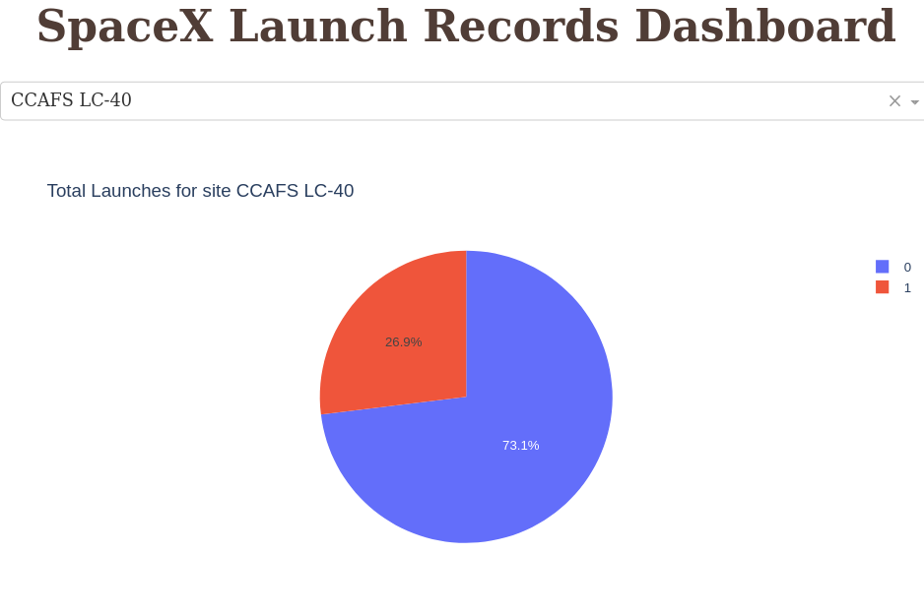
Total Launches for Site CCAFS LC-40
Visualizes successful launch ratio for the launch site with the best success rate
0 -> success
1 -> fail

Slide 41
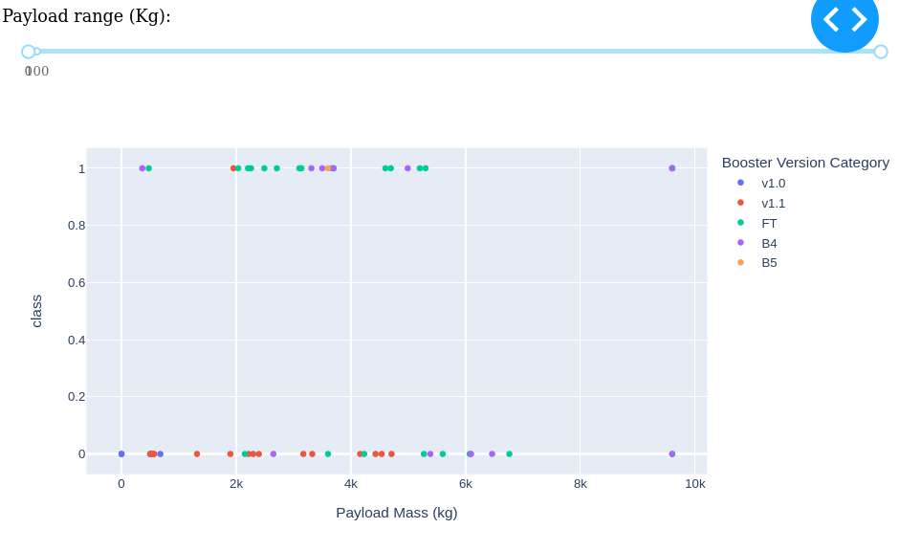
Payload vs Launch Outcome
Most successful Booster Version: FT
Most successful Payload Mass: over 7000 kg

Slide 42

Section 5

Slide 43
Classification Accuracy
Decision Tree Classifier had the best model accuracy on the train data
Test accuracy remained the same across all models
Issue with amount of data

Slide 44
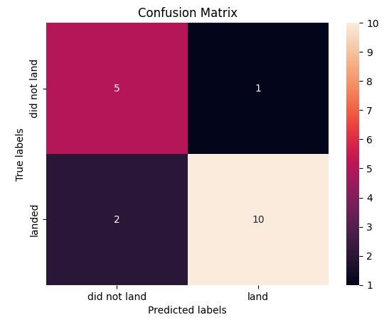
Confusion Matrix
Decision Tree Classifier Confusion Matrix
3 incorrectly labeled launches
15 correctly labeled launches

Slide 45

Conclusions
Decision Tree Classifier is our best prediction model
Refining model necessary to predict successful launches and increase profits
Launch Site with most success: KSC LC-39A
Successful landing outcomes increased over time, showcasing improvements of rocket technology and techniques
Launch Site location details provided with Folium maps

Slide 46

Appendix
Repository: https://github.com/Blu-LeBlanc/IBM-Data-Science-Labs/tree/main
*Note: Folium Maps do not render on github

Slide 47


